Slide 1
Abishek R R 962821205003 B.Tech-IT 3rd Year UCEN
Final Project
3/21/2024 Annual Review

Slide 2
PROJECT TITLE
FACE EXPRESSION RECOGNITION USING CNN
3/21/2024 Annual Review

Slide 3


AGENDA
Problem Statement
Project Overview
End Users
Solution
Value Proposition
Wow in the Solution
Modelling
Result
3/21/2024 Annual Review

Slide 4

PROBLEM STATEMENT
Traditional methods often struggle with variations in facial expressions, lighting conditions, and occlusions, leading to reduced accuracy and reliability. Additionally, manual analysis of facial expressions is labor-intensive and subjective. Consequently, there is a demand for an automated facial expression recognition system that can efficiently detect and classify emotions in real-time, enabling various applications in fields such as entertainment, market research, education, healthcare, gaming, retail, and automotive sectors.
3/21/2024 Annual Review

Slide 5

PROJECT OVERVIEW
Developing a CNN-based system to accurately recognize facial expressions, leveraging deep learning to classify emotions like happiness, sadness, anger, surprise, fear, disgust, and neutrality. The trained model enables real-time emotion detection for applications in entertainment, market research, education, healthcare, gaming, retail, and automotive sectors, enhancing user experiences and enabling innovative applications across diverse industries.
3/21/2024 Annual Review

Slide 6

WHO ARE THE END USERS?
Entertainment Industry: Analyzing audience reactions in media content.
Market Research Firms: Gauging consumer sentiment and emotional responses.
Education Sector: Assessing student engagement and understanding.
Healthcare Providers: Diagnosing and monitoring mental health conditions.
Human-Computer Interaction: Developing emotionally intelligent interfaces.
Gaming Industry: Creating immersive gaming experiences.
Retail Industry: Personalizing customer experiences based on emotional cues.
Automotive Sector: Designing vehicles that respond to driver emotions.
3/21/2024 Annual Review

Slide 7

SOLUTION
The solution involves developing a facial expression recognition system using convolutional neural networks (CNNs) and deep learning techniques. By leveraging CNNs, known for their effectiveness in image recognition tasks, the system will be able to analyze facial features and expressions to accurately classify emotions such as happiness, sadness, anger, surprise, fear, disgust, and neutrality. Through training on labeled datasets, the CNN model will learn to identify subtle facial cues indicative of different emotions, enabling robust and real-time emotion detection. This solution will address the challenges posed by traditional methods by providing a reliable and automated system for facial expression recognition, facilitating applications in various domains and enhancing user experiences across diverse industries.
3/21/2024 Annual Review

Slide 8
VALUE PROPOSITION
Accuracy: The CNN model can effectively analyze facial features and expressions to classify emotions with high accuracy, surpassing traditional methods.
Efficiency: Automated facial expression recognition enables real-time emotion detection, streamlining processes and enhancing efficiency compared to manual analysis.
Versatility: The system's adaptability allows it to be deployed across various industries and applications, including entertainment, market research, education, healthcare, gaming, retail, and automotive sectors.
Enhanced User Experiences: By interpreting human emotions, the system facilitates personalized and emotionally intelligent interactions, leading to improved user experiences and satisfaction.
Innovation: The project drives innovation by enabling the development of emotion-aware technologies and services, opening up new possibilities for enhancing human-computer interaction and user engagement.
3/21/2024 Annual Review

Slide 9

THE WOW IN YOUR SOLUTION
The integration of multimodal data fusion techniques to enhance the accuracy and robustness of facial expression recognition. This approach involves combining information from multiple sources, such as facial images, audio signals, and contextual data, to provide a more comprehensive understanding of human emotions.
3/21/2024 Annual Review
9

Slide 10
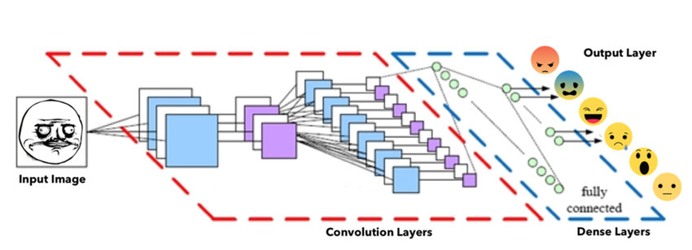
MODELLING
Project Architecture
3/21/2024 Annual Review
10

Slide 11
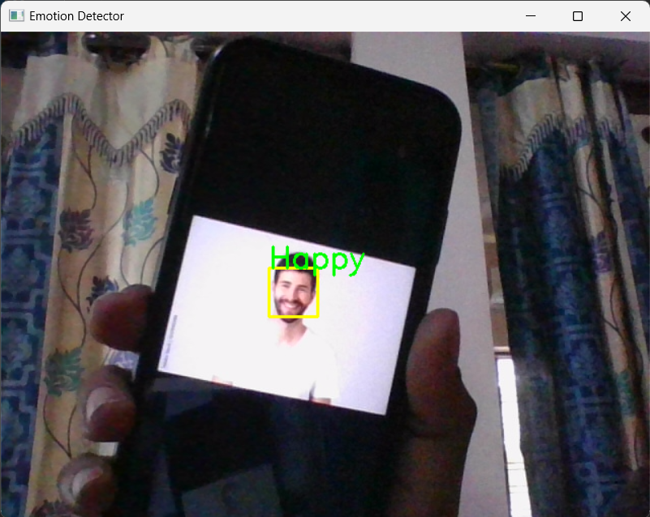
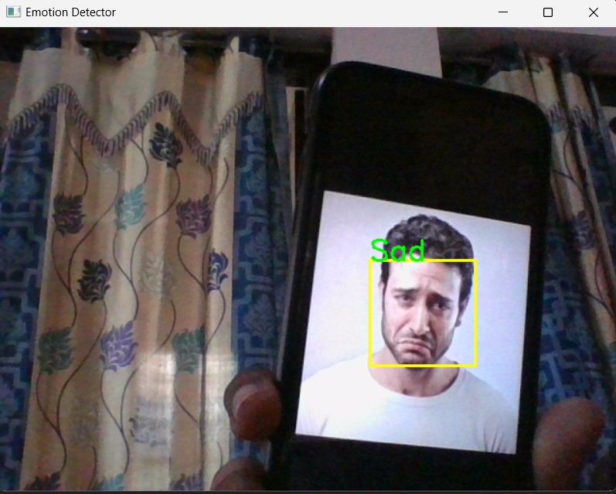
RESULTS
3/21/2024 Annual Review
11

